Slide 1
Performance of A Parallel-by-Row Alpha-Beta Minimax Game-Playing Algorithm.
*Also known as “research common parallel strategies, and THEN work out the code!”

Slide 2
First: some things to know/refresher
Alpha Beta Minimax is used for nearly all game-playing A.I.s
The game being played doesn’t matter (mostly).
Minimax (with or without cutoffs) rapidly becomes untenable.

Slide 3
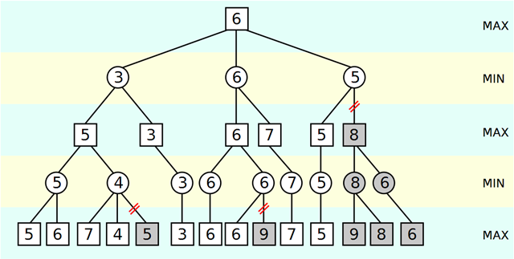
More refresher:
The Alpha Beta Cutoff.

Slide 4
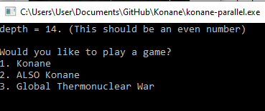
About Konane:
A 2-person board game on a checkered board. Lends itself to row-based parallel implementation fairly well.
Every move is a capture move
If no moves left, you lose
Very simple game

Slide 5
About the project:
Parallel-by-rows-implementation shows the problems with sacrificing root cutoffs, but also highlight where gains occuring elsewhere.
20 second gain (average) at depth of 16, a 21 min game, 7 seconds in a rapid game at depth of 14.
Different number of moves. ‘same’ result

Slide 6
More about the Project:
Parallel By Rows is a robust strategy to avoid deadlock.
Overall turn length spikes at some point, but early turns can be significantly faster than later ones
More risks should be taken in the future iterations of the program.

Slide 7
About Methods Used:
The same start was used for every test.
Performance variation is similar for any legal start, but for consistency of test, the same start was used each time.

Slide 8
Materials used:
Materials used: C++17 , the standard library thread object, and intel 4-core processor on capable hardware.
The same hardware and nearly identical code for both.

Slide 9
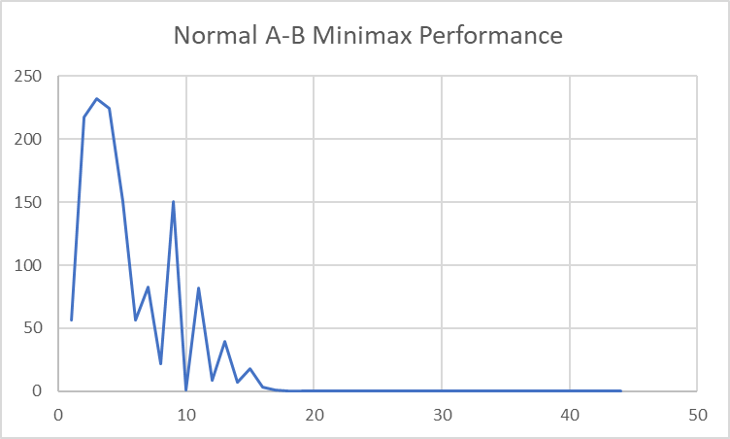

Slide 10
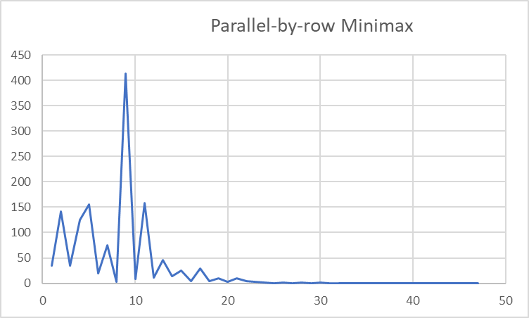

Slide 11
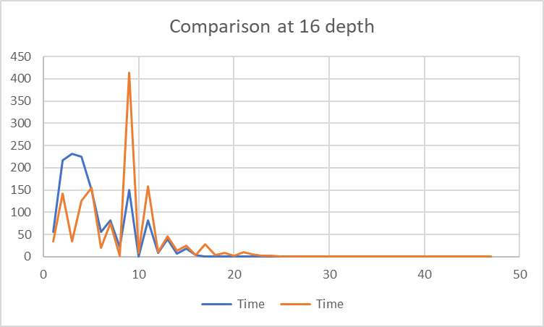

Slide 12
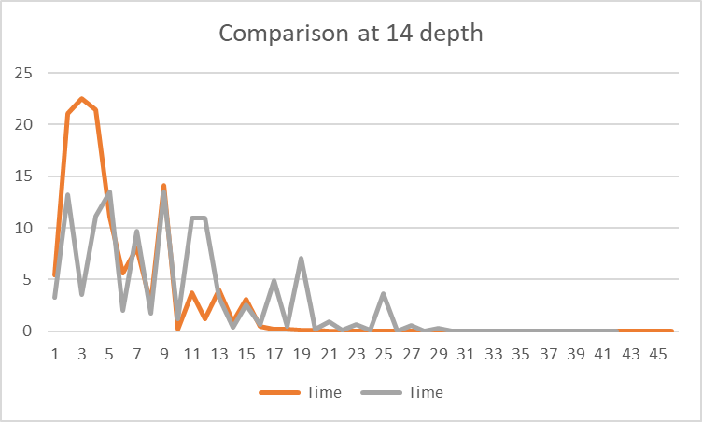

Slide 13
Conclusions:
Alpha-Beta Cutoffs still pay off at the root
Parallel by Rows is a suboptimal strategy, though it is robust in terms of isolating threads
Minimal gains over the course of a game
Mere brute force will not make the algorithm significantly faster.
20 sec0nd gain at 16.
7 seconds at 14
Image of Minimax tree website credit:
Minimax algorithm와 Alpha-beta pruning – NoSyu의 주저리주저리

Slide 14
Oddities
The number of turns and outcome changes at depth of 16 with the parallel-by-rows implementation (different moves are taken earlier, leading to a different board state).

